Slide 1
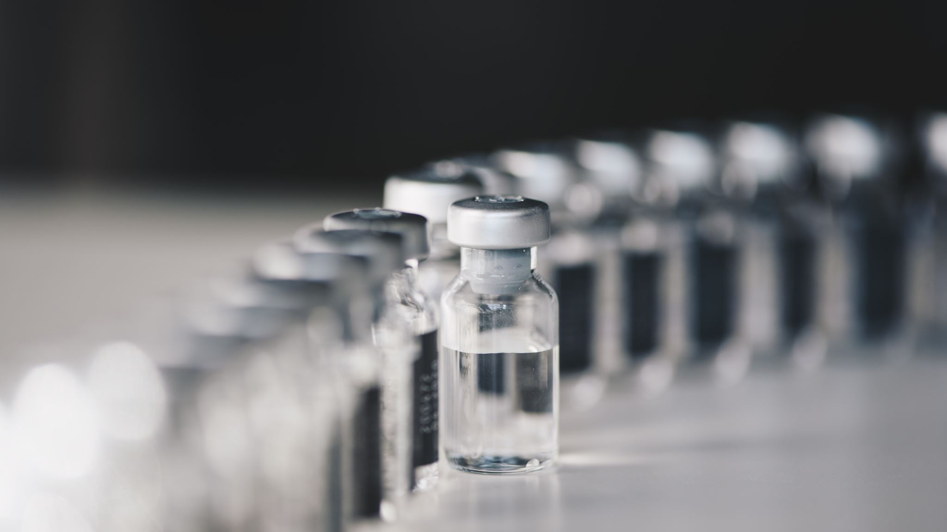
Impact of Interventions on COVID-19
Safia Nasuuna

Slide 2
Overview
Research objective: Explore impact of pharmaceutical interventions on COVID-19 infection, severe illness and deaths in the UK

Slide 3
Background
Publicly available data
Our World in Data
“most recent official numbers from governments and health ministries worldwide” (OWID)
Intervention 1: Vaccine 8 Dec 2020
Intervention 2: Vaccine 16 June 2021

Slide 4
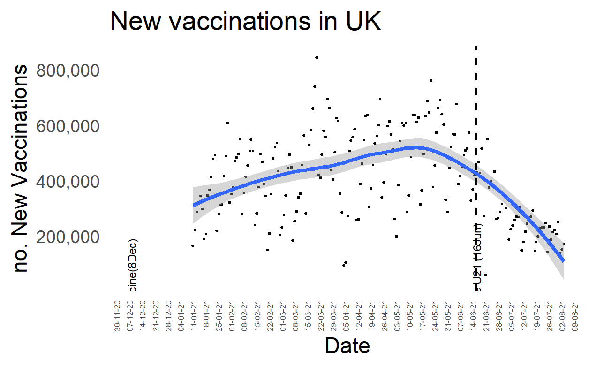
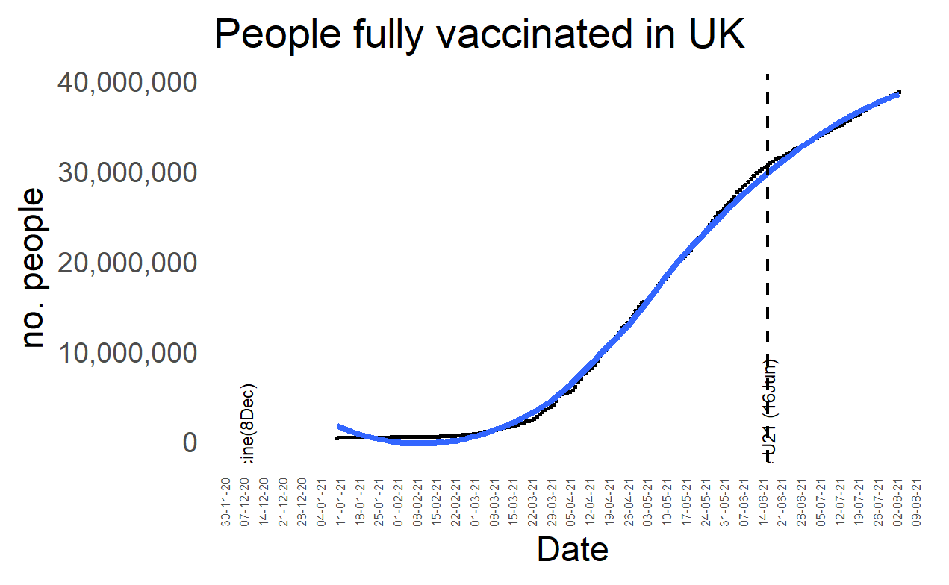
Vaccinations

Slide 5
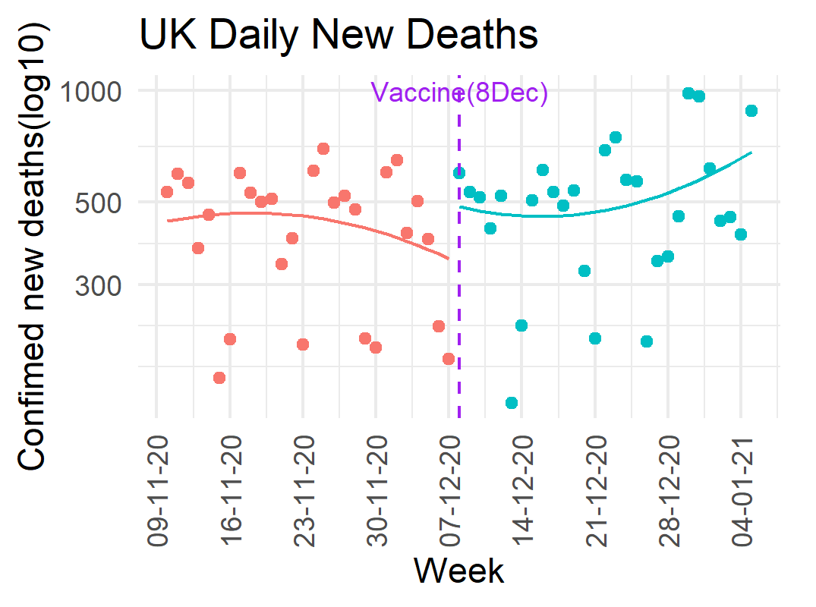
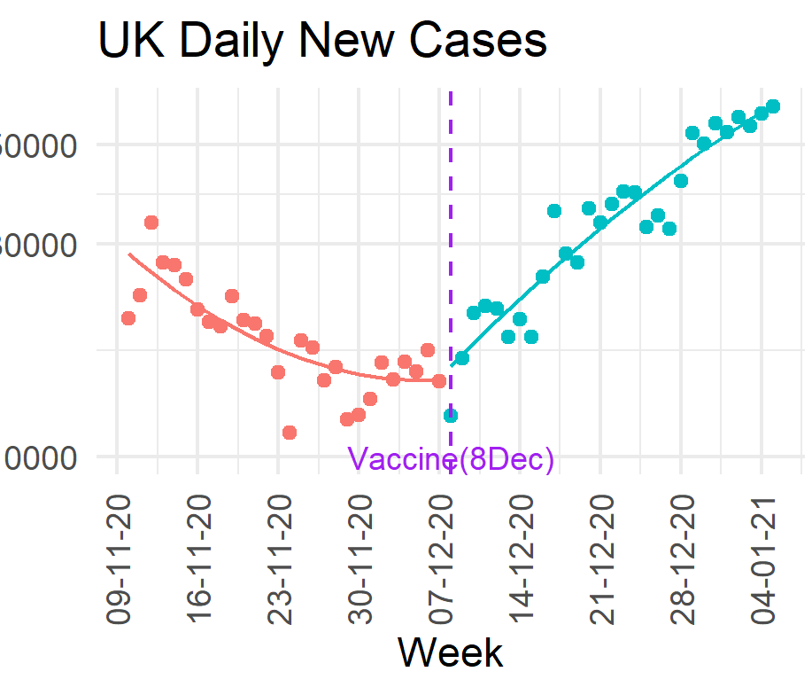
Vaccine first release results

Slide 6
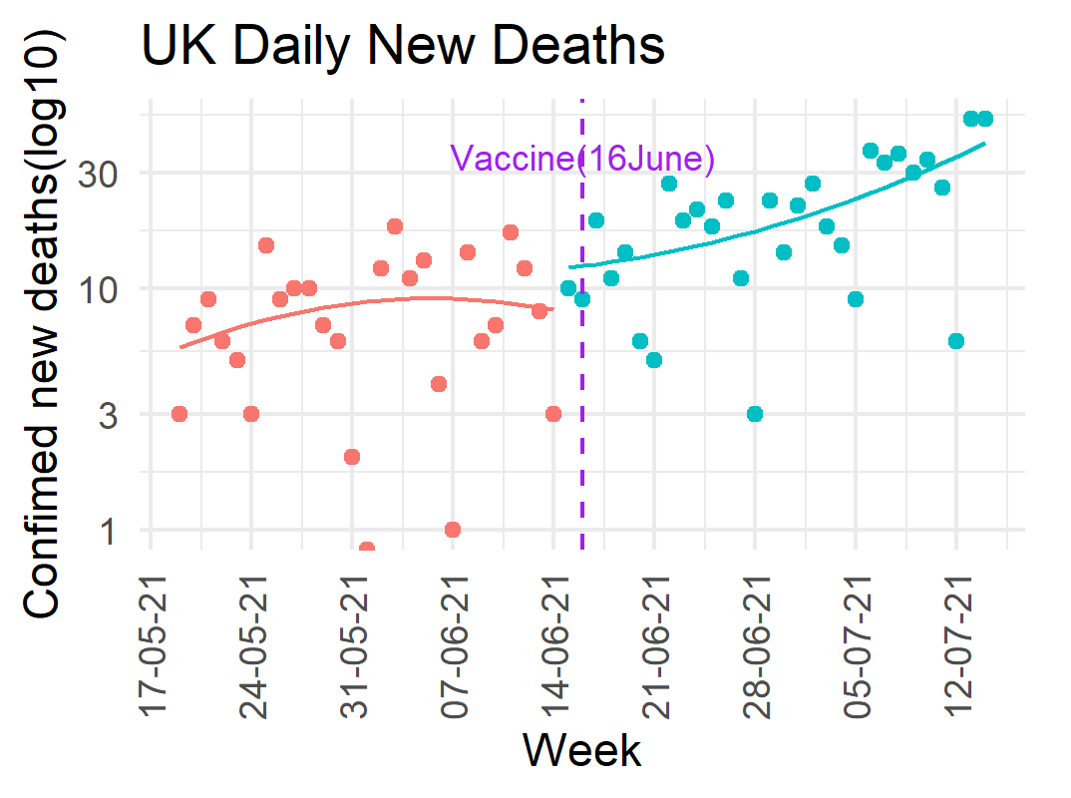
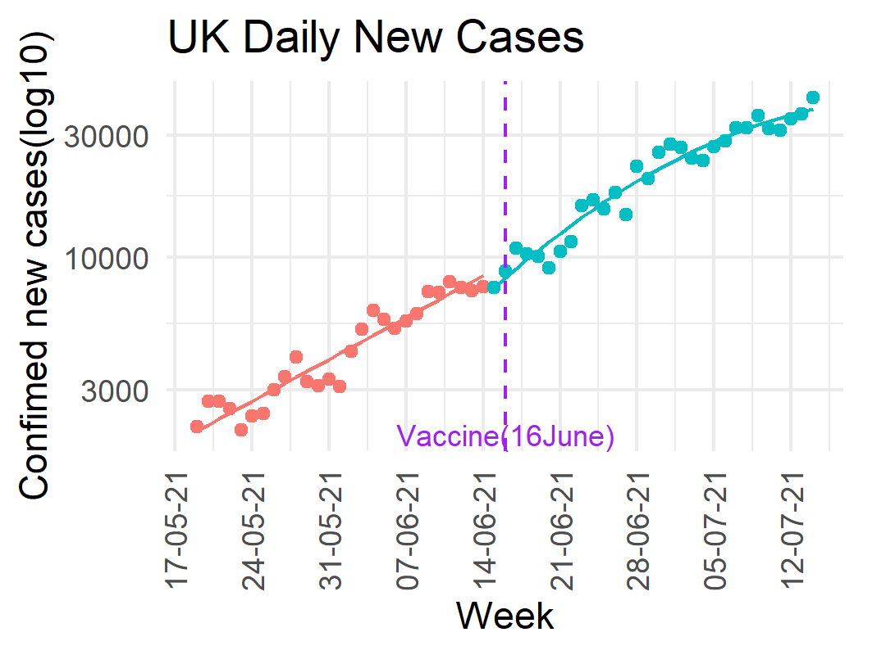
Vaccine second release results

Slide 7
Conclusions
Strengths
Impactful research
Limitations
Impossible to isolate intervention

